Slide 1
Software Cache Coherent Control by
Parallelizing Compiler
Boma A. Adhi, Masayoshi Mase, Yuhei Hosokawa, Yohei Kishimoto
Taisuke Onishi, Hiroki Mikami, Keiji Kimura, Hironori Kasahara
Department of Computer Science and Engineering
Waseda University

Slide 2
What is Cache Coherency?
PE0
PE1
CPU
CPU
PE0 Cache
- | - | - | -
PE1 Cache
- | - | - | -
Cache coherency:
Data should be consistent from all
CPU Core
cache
cache
Interconnection Network
Shared memory
1 | - | - | -
x
Notes:
A read by processor P to a location X that follows a write by P to X, with no writes of X by another processor occurring between the write and the read by P, always returns the value written by P.
A read by a processor to location X that follows a write by another processor to X returns the written value if the read and write are sufficiently separated in time and no other writes to X occur between the two accesses
Writes to the same location are serialized; that is, two writes to the same location by any two processors are seen in the same order by all processors. For example, if the values 1 and then 2 are written to a location, processors can never read the value of the location as 2 and then later read it as 1.

Slide 3
What is Cache Coherency?
PE0
PE1
load x;
load x;
CPU
CPU
PE0 Cache
1 | - | - | -
PE1 Cache
1 | - | - | -
x
x
cache
cache
Interconnection Network
Shared memory
1 | - | - | -
x
Notes:
A read by processor P to a location X that follows a write by P to X, with no writes of X by another processor occurring between the write and the read by P, always returns the value written by P.
A read by a processor to location X that follows a write by another processor to X returns the written value if the read and write are sufficiently separated in time and no other writes to X occur between the two accesses
Writes to the same location are serialized; that is, two writes to the same location by any two processors are seen in the same order by all processors. For example, if the values 1 and then 2 are written to a location, processors can never read the value of the location as 2 and then later read it as 1.

Slide 4
What is Cache Coherency?
PE0
PE1
x = 2;
CPU
CPU
PE0 Cache
1 | - | - | -
PE1 Cache
2 | - | - | -
x
x
x is now invalid
cache
cache
Interconnection Network
Shared memory
1 | - | - | -
x
Notes:
A read by processor P to a location X that follows a write by P to X, with no writes of X by another processor occurring between the write and the read by P, always returns the value written by P.
A read by a processor to location X that follows a write by another processor to X returns the written value if the read and write are sufficiently separated in time and no other writes to X occur between the two accesses
Writes to the same location are serialized; that is, two writes to the same location by any two processors are seen in the same order by all processors. For example, if the values 1 and then 2 are written to a location, processors can never read the value of the location as 2 and then later read it as 1.

Slide 5
Why Compiler Controlled Cache Coherency?
Current many-cores CPU (Xeon Phi, TilePro 64, etc) uses hardware cache coherency mechanism.
Hardware cache coherency for many-cores (hundreds to thousand cores) :
  Hardware will be complex & occupy large area in silicon
  Huge power consumption
  Design takes long time & larger cost
Software based coherency:
  Small hardware, low power & scalable
  No efficient software coherence control method has been proposed.

Slide 6
Proposed Software Coherence Method on OSCAR Parallelizing Compiler
Coarse grain task parallelization with earliest condition analysis (control and data dependency analysis).
OSCAR compiler automatically controls coherence using following simple program restructuring methods:
  To cope with stale data problems:
    Data synchronization by compilers
  To cope with false sharing problem:
    Data Alignment
    Array Padding
    Non-cacheable Buffer
MTG generated by earliest executable condition analysis

Slide 7
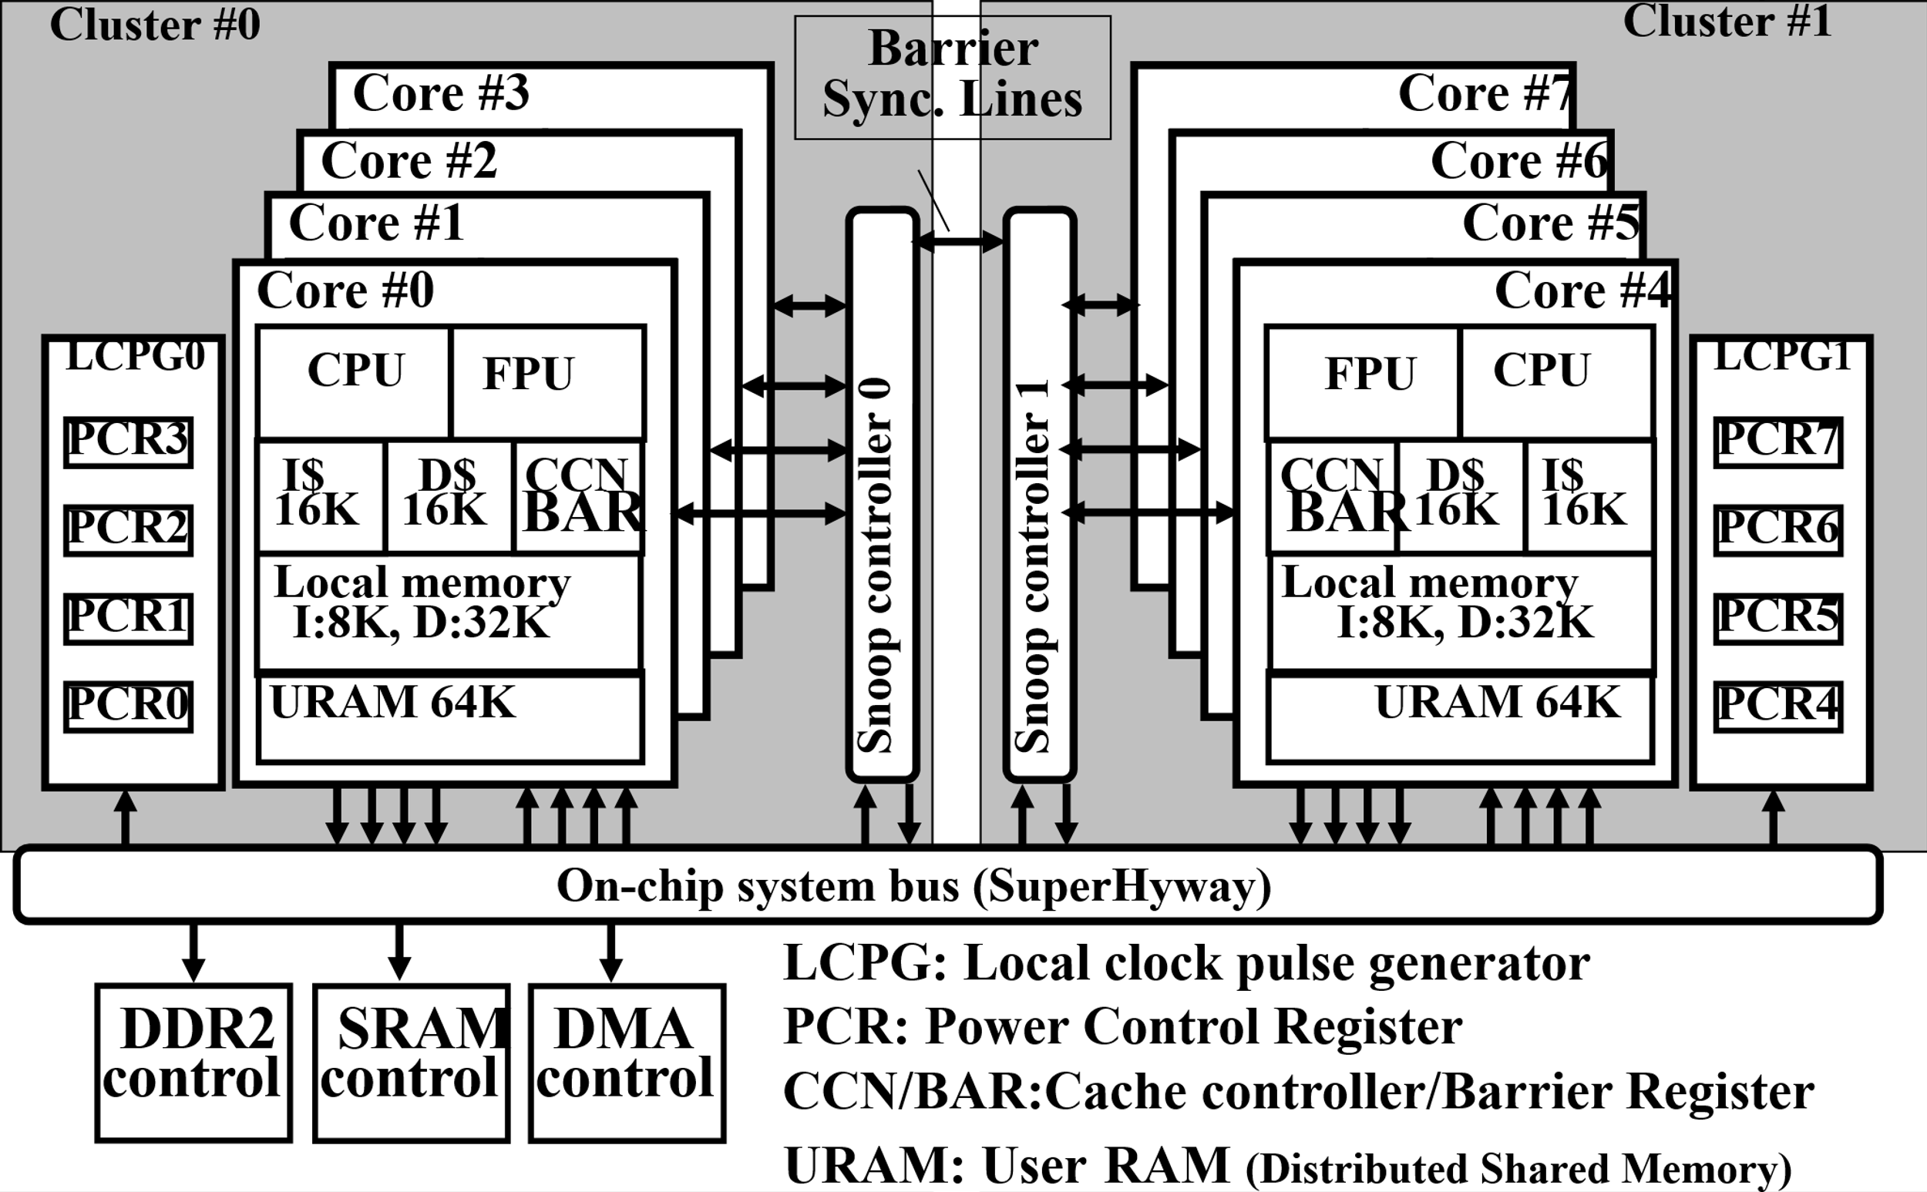
The Renesas RP2 Embedded Multicore
2 clusters of 4 cores hardware cache coherent control SMP,
No coherence support for more than 5 cores

Slide 8

Non Coherent Cache Architecture
Local Cache
V
D
tag
data
PE0
PE1
PEn
CPU
CPU
CPU
V: valid bit
D: dirty bit
Local
Cache
Local
Cache
Local
Cache
…
local cache control instructions
from the owner CPU
self-invalidate
Writeback
flush
Interconnection Network
Shared Memory

Slide 9





Problem in Non-coherent Architecture (1):
Stale Data
a
b
c
Global Variable Declaration
int a = 0;
int b = 0;
int c = 10;
Shared Memory
PE0
PE1
a = 0;
b = 0;
Stale Data:
An obsolete shared data exists on a processor cache after a new value is updated by another processor core
PE1 Cache
b = a;
Time
PE0 Cache
a = 20;
a = 20;
If the data on the cache
continue to exist
PE1 Cache
a = 0;
c = 0;
c = a;
Correct value with coherent control
a=20 by PE0 is not published and PE1 calculates c using stale data
Value is not coherent

Slide 10
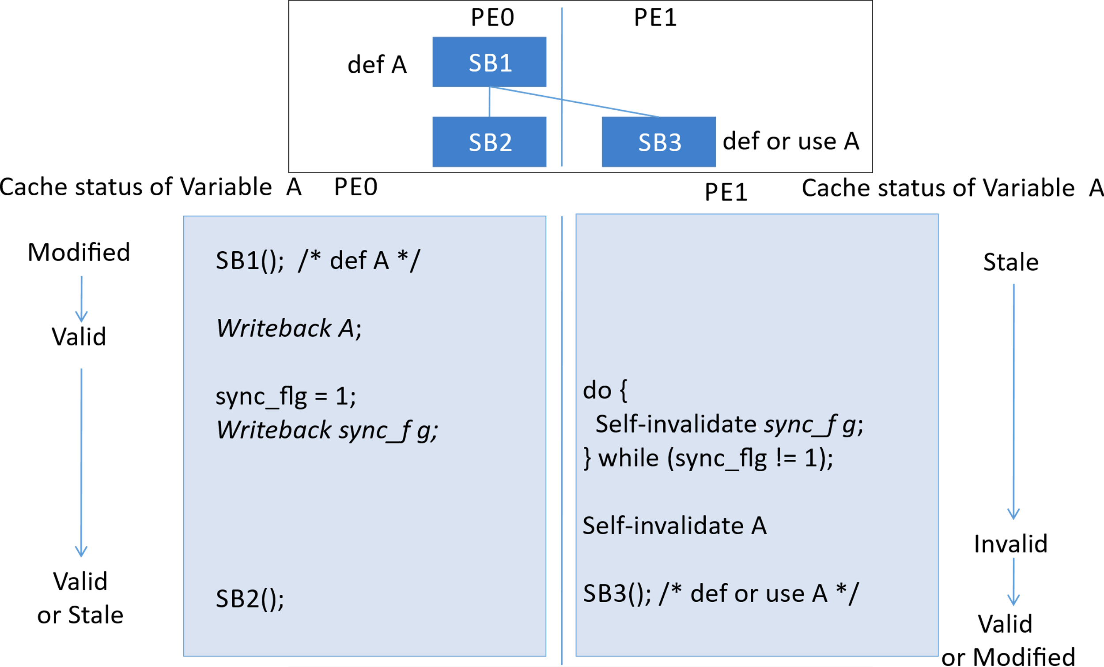
Solving Stale Data Problem
The compiler automatically inserts a writeback instruction and a synchronization barrier on PE0 code.
Then, it inserts a self-invalidate instruction on PE1 after the synchronization barrier.

Slide 11





Problem in Non-coherent Architecture (2):
False Sharing
Global Valuable Declaration
int a = 0;
int b = 0;
Shared Memory
a and b are different elements on the same cache line
a
b
False sharing:
A condition which multiple cores share the same memory block or cache line. Then, each processor updates the different elements on the same block/cache line.
PE0
PE1
a = 10;
b = 20;
PE0 Cache
PE1 Cache
time
line
line
Line replacement
Line replacement
Memory
With cache coherency:
a
b
Depending on the timing of the line replacement, the stored data will be inconsistent.

Slide 12


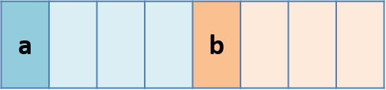

Solving False Sharing (1): Data Alignment
Data alignment solve the false sharing problem.
Different data accessed by different PE should not share a single cache line.
This approach works for scalar variables and small-sized one-dimensional array.
Variable Declaration
int a __attribute__((aligned(16))) = 0;
int b __attribute__((aligned(16))) = 0;
/* a, b are assigned to the first element of each cache line */
PE0
PE1
a = 10;
b = 20;
a and b are assigned to the first elements of different cache lines
PE0 Cache
PE0 Cache
line1
line2
Mem
Updates by PE0 and PE1 are separately performed by write back

Slide 13
Two-dimensional Array Problem
Splitting an array cleanly along the cache line is not always possible.
  Lowest dimension is not integer multiply of cache line
(0,0)
cache line
(1,0)
PE0 write
int a[6][6];
PE0
PE1
(2,0)
for (i = 0; i < 3; i++) {
for (j = 0; j < 6; j++) {
a[i][j] = i * j;
}
}
for (i = 3; i < 6; i++) {
for (j = 0; j < 6; j++) {
a[i][j] = i * j;
}
}
(3,0)
PE0 & PE1 share cache line
(4,0)
(5,0)
PE1 write

Slide 14

Solving False Sharing (2): Array Padding
Memory
The compiler inserts a padding (dummy data) to the end of the array to match the cache line size
a
(1,0)
(1,1)
(1,2)
(1,3)
cache line
(1,4)
(1,5)
(1,6)
(1,7)
int a[6][8] __attribute__((aligned(16)));
/* a is aligned to the first element of the cache line */
(2,0)
PE0 write
PE0
PE1
(3,0)
for (i = 0; i < 3; i++) {
for (j = 0; j < 6; j++) {
a[i][j] = i * j;
}
}
for (i = 3; i < 6; i++) {
for (j = 0; j < 6; j++) {
a[i][j] = i * j;
}
}
(4,0)
(5,0)
PE1 write
(6,0)

Slide 15


Solving False Sharing (3):
Non-cacheable Buffer
a
cache line
(1,0)
(2,0)
(3,0)
PE0 write
Data transfer using non-cacheable buffer:
The idea is to put a small area in the main memory that should not be copied to the cache along the border between area modified by different processor core.
int a[6][6] __attribute__((aligned(16)));
/* a is assigned to the first element of the cache line */
int nc_buf[1][6] __attribute((section(“UNCACHE”)));
/* nc_buf is prepared in non-cacheable area */
(4,0)
(5,0)
PE1 write
PE0
PE1
b
cache line
for (i = 1; i < 4; i++) {
for (j = 0; j < 6; j++) {
a[i][j] = i * j;
b[i-1][j] = i * j;
}
}
for (i = 4; i < 5; i++) {
for (j = 0; j < 6; j++) {
a[i][j] = i * j;
nc_buf[i-4][j] = i * j;
}
}
(0,0)
(1,0)
PE0 write
(2,0)
for (i = 4; i < 5; i++) {
for (j = 0; j < 6; j++) {
b[i-1][j] = nc_buf[i-4][j];
}
}
for (i = 5; i < 6; i++) {
for (j = 0; j < 6; j++) {
a[i][j] = I * j;
b[i-1][j] = i * j;
}
}
(3,0)
Data transfer using buffer
(4,0)
(5,0)
PE1 write

Slide 16
Performance Evaluation
10 Benchmark Application in C
  In Parallelizable C format (Similar to Misra C in embedded field)
  Fed into source to source automatic parallelization OSCAR Compiler with non-cache coherence control
  Parallelized code then fed into Renesas C Compiler
Evaluated in RP2 Processor
  8 core
  Dual 4 core modules
  Hardware cache coherency for up to 4 cores in the same module

Slide 17
Performance of Hardware Coherence Control & Software Coherence Control on 8-core RP2

Slide 18
SPEC Result

Slide 19
NAS Parallel Benchmark and MediaBench II

Slide 20
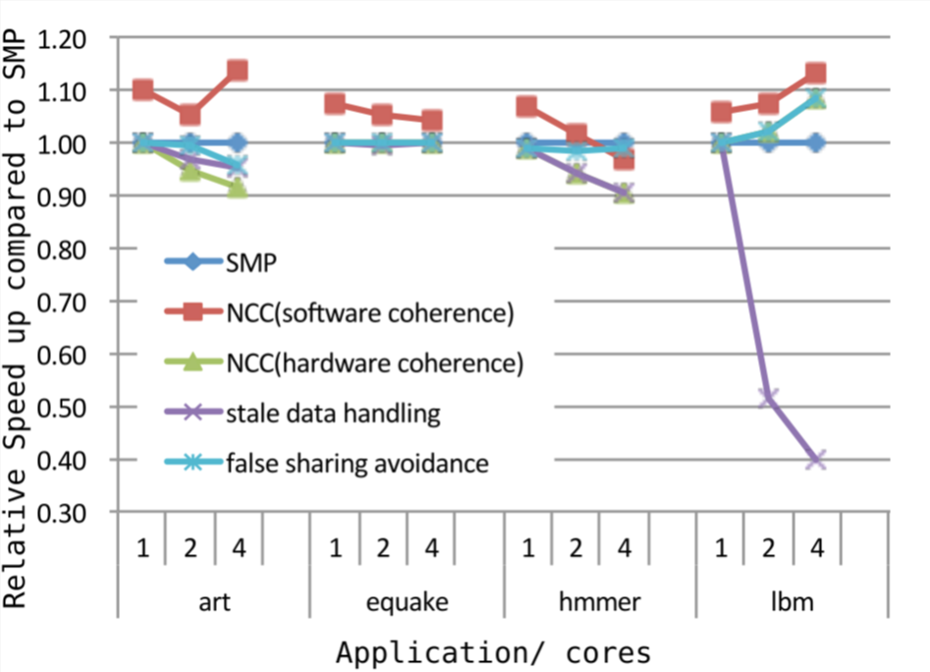
Software Coherence Impact on Performance
SMP: Hardware cache coherence (baseline).
NCC(soft): Both stale data handling and false sharing turned on. Hardware CC off.
NCC(hard): All stale data handling , false sharing turned on and also Hardware CC on.
Stale Data Handling only. Hardware CC off.
False Sharing Avoidance only. Hardware CC off.

Slide 21
Conclusions
OSCAR compiler automatically controls coherence using following simple program restructuring methods:
  To cope with stale data problems:
    Data synchronization by compilers
  To cope with false sharing problem:
    Data Alignment
    Array Padding
    Non-cacheable Buffer
Evaluated using 10 benchmark applications Renesas RP2 8 core multicore processor.
  SPEC2000
  SPEC2006
  NAS Parallel Benchmark
  MediaBench II

Slide 22
Conclusion (cont’d)
Provides good speedup automatically, few examples with 4 cores:
  2.63 times SPEC2000 equake (2.52 with hardware)
  3.28 times SPEC2009 lbm (2.9 with hardware)
  3.71 times on NPB cg (3.34 with hardware)
  3.02 times on MediaBench MPEG2 Encoder (3.17 with hardware)
Enable usage of 8 cores automatically on RP2 with good speedup:
  4.37 times SPEC2000 equake
  4.76 times SPEC2009 lbm
  5.66 times on NPB cg
  4.92 times on MediaBench MPEG2 Encoder

Slide 23
Thank you

